Slide 1



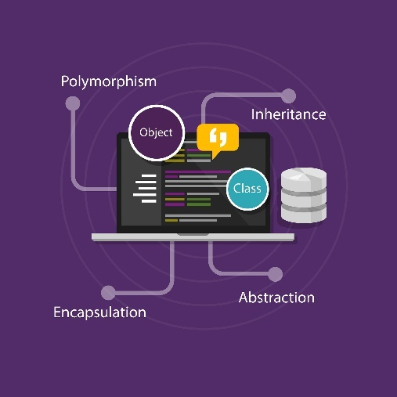

OOP Basics
Course Overview
Java OOP
SoftUni Team
Ventsislav Ivanov
Software University
http://softuni.bg

Slide 2



Table of Contents
What are Objects?
What is OOP?
OOP Principles
High Quality Classes
Cohesion and Coupling

Slide 3

What are Objects?
Real-Life Objects in Programming

Slide 4

What are Objects?
class Person {
Double height;
String skinColor;
List<Clothes> clothes;
}
class Person {
Integer age;
String hairColor;
List<Clothes> clothes;
}

Slide 5


Initialization of Object
Person ventsi = new Person();
Person ventsi =
new Person(27, "Brown");

Slide 6
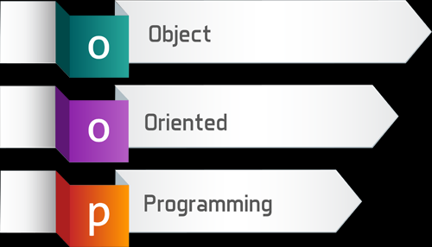
What is OOP?
Object Oriented Programming

Slide 7
What is Object-Oriented Programming?
OOP is a programming paradigm based on the concept of objects
Objects consist of data (properties) and behavior (methods)
Properties
Object
Methods

Slide 8

Four Pillars of OOP

Slide 9
Encapsulation
Class data should be hidden
Accessed only through public methods
What algorithm is used to take the substring?
String text = "Some text";
String substring = text.substring(2, 4);
Don't know and don't care!
Won't even notice if it changes

Slide 10
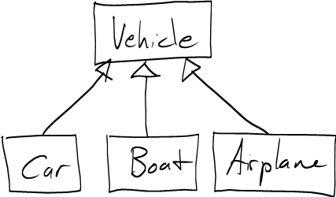
Inheritance
Process where one class acquires the properties of another
Information is made manageable in a hierarchical order
Car inherits all properties/methods of Vehicle

Slide 11
Polymorphism
Ability of an object to take on many forms
Parent class reference is used to refer to a child class object
A car is a car
A car is also a vehicle

Slide 12
Abstraction
Focus on necessary context for user
I need the Color of a Vehicle – can use Vehicle
I need Transmission Type – must use Car

Slide 13
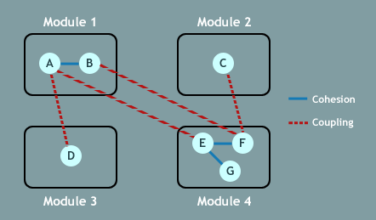


Cohesion and Coupling
key
value
Strong Cohesion and Loose Coupling

Slide 14
Cohesion
Measures the strength of relationship between pieces of functionality within a given module / class
Strong Cohesion
Weak Cohesion
class Staff
void setSalary()
double getSalary()
void paySalary()
class Staff
void checkMail()
void sendMail()
void printMail()
void saveMailInDB()

Slide 15
Coupling
How related are two modules / classes
A class / module cannot be used without another class
A change in a class will affect all classes it is coupled to

Slide 16







OOP Overview
https://softuni.bg/courses/

Slide 17





Trainings @ Software University (SoftUni)
Software University – High-Quality Education, Profession and Job for Software Developers
softuni.bg
Software University Foundation
http://softuni.foundation/
Software University @ Facebook
facebook.com/SoftwareUniversity
Software University Forums
forum.softuni.bg

